Slide 1
Crazy Button Workshop
NTU SCSE
09/12/2023

Slide 2
Let’s Play!
https://crazy-button.onrender.com/

Slide 3
Breakdown
Part 1: Introduction
Client-Server Architecture
WebSocket
Overall Model
Frontend Overview
Backend Overview
Part 2: Hands-on Coding
5 Stages of progression
Built towards the final web app
Creative time and quiz

Slide 4
1.
Introduction
Let’s start get started!!
Notes:
Lets get started!!

Slide 5
What we will be building
A platform with:
Button
It moves to a random location when it is pressed
Leaderboard
Notes:
We will be building a platform with
-a button
-which moves to random location when its pressed
-a leaderboard

Slide 6
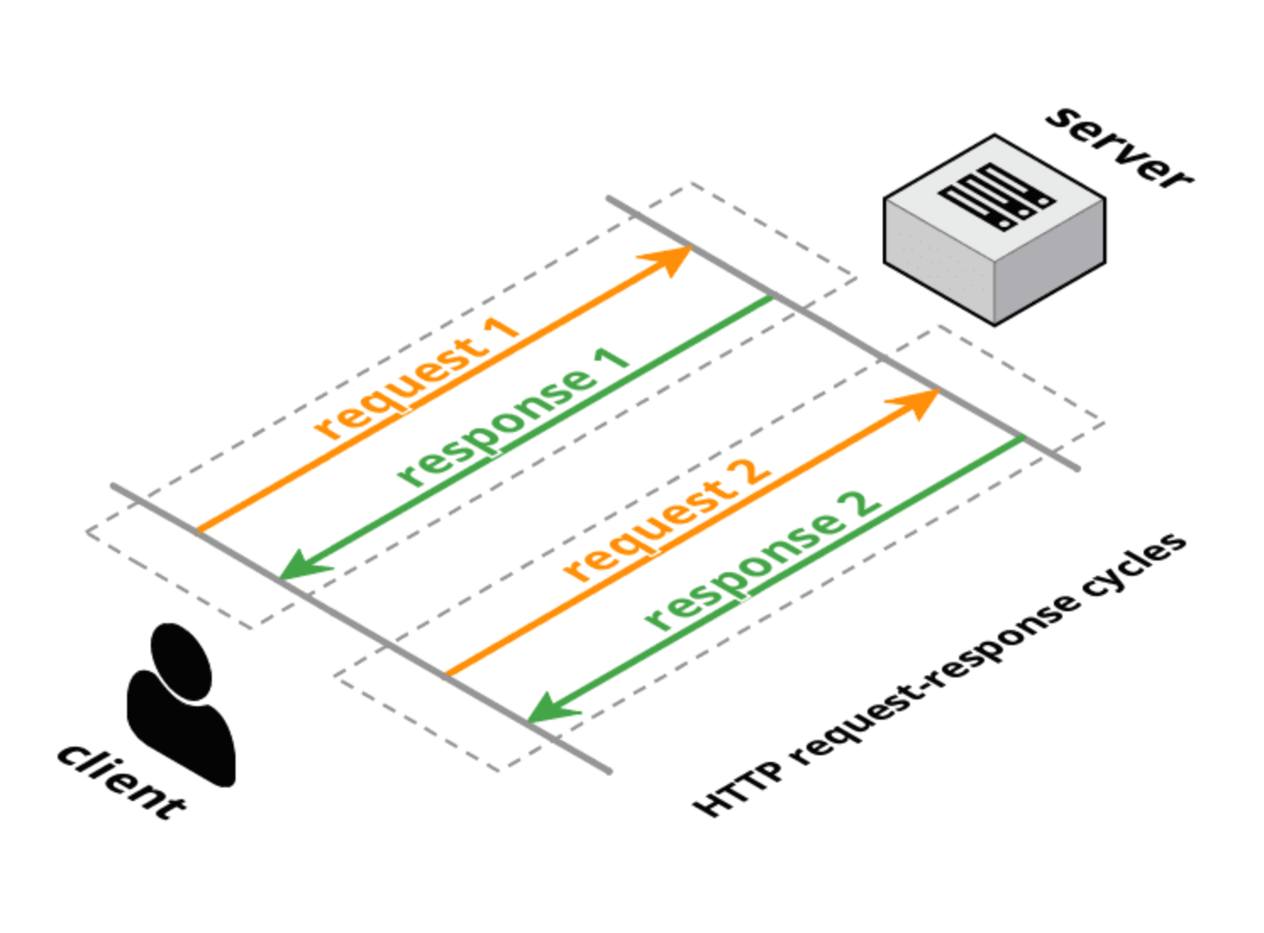
What is Client-Server Architecture?
Client request
Server respond with data
Repeat
Notes:
First let’s introduce the client-server architecture
It is like a communication between the client and the server.
First the Client will request for something
Then the server will respond with the data

Slide 7
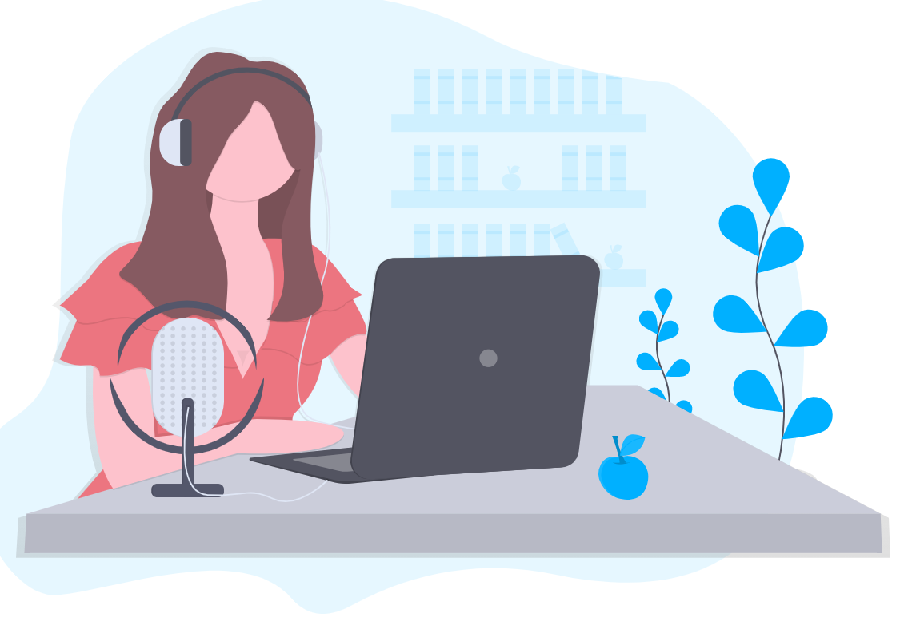

Eg. Youtube
I want to watch “XYZ”
“XYZ video”
Client
Server

Slide 8
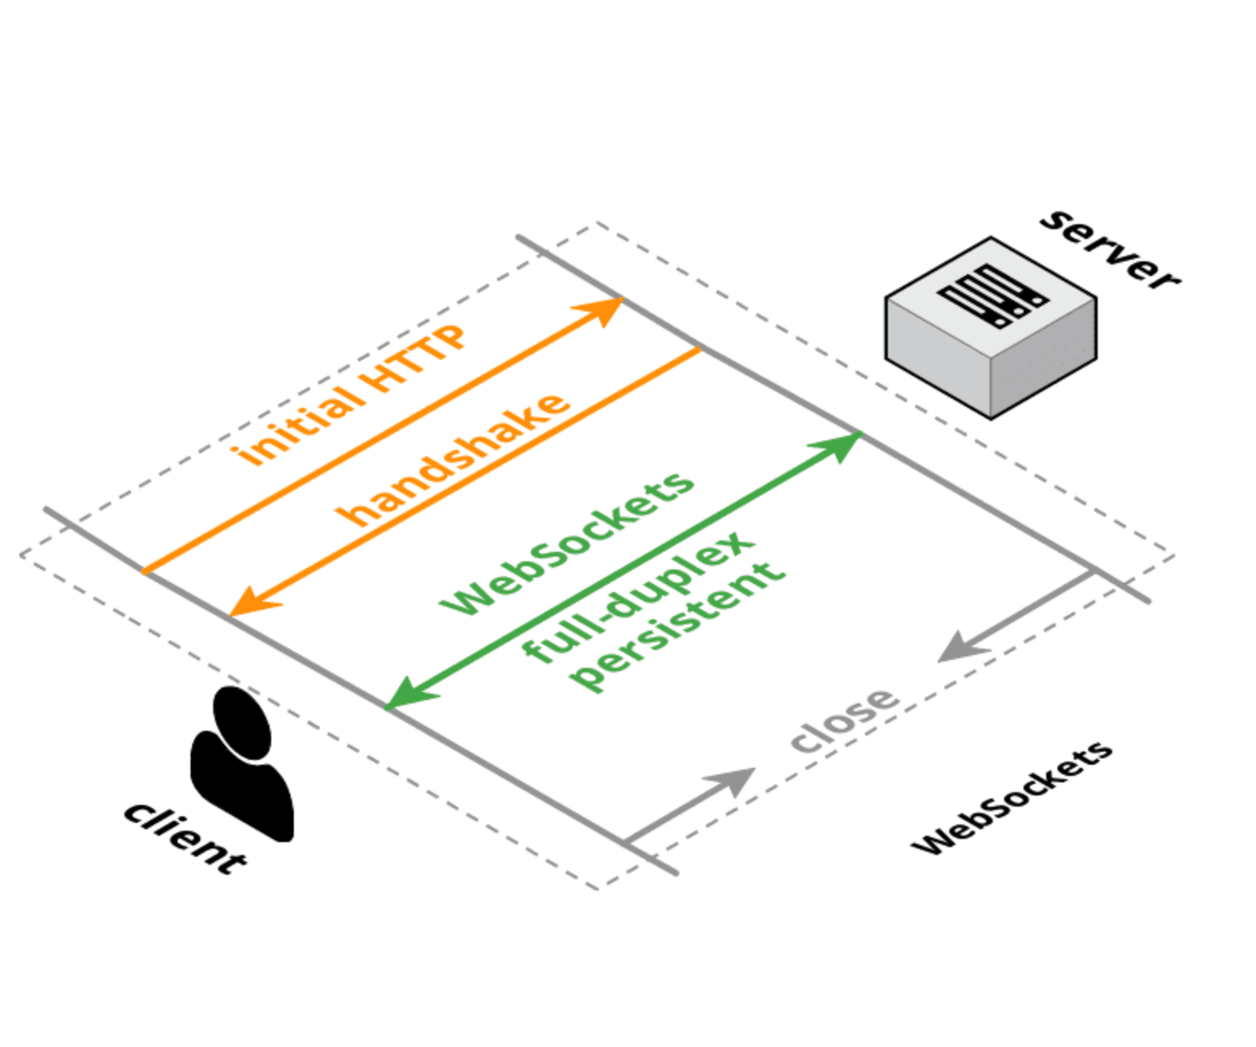
What is WebSocket?
Client request for handshake
Server respond with “OK”
Handshake established
Data can be transmitted through the handshake
Notes:
Websocket is built ontop of client-server architecture

Slide 9

Eg. Facebook
“Handshake?”
Connection
“OK”
Client
Server
Notes:
Facebook does not really use websocket.
We change example?

Slide 10
Why WebSocket?
Real time communication
Full duplex
Once button pressed, position will be updated on all players’ screen

Slide 11
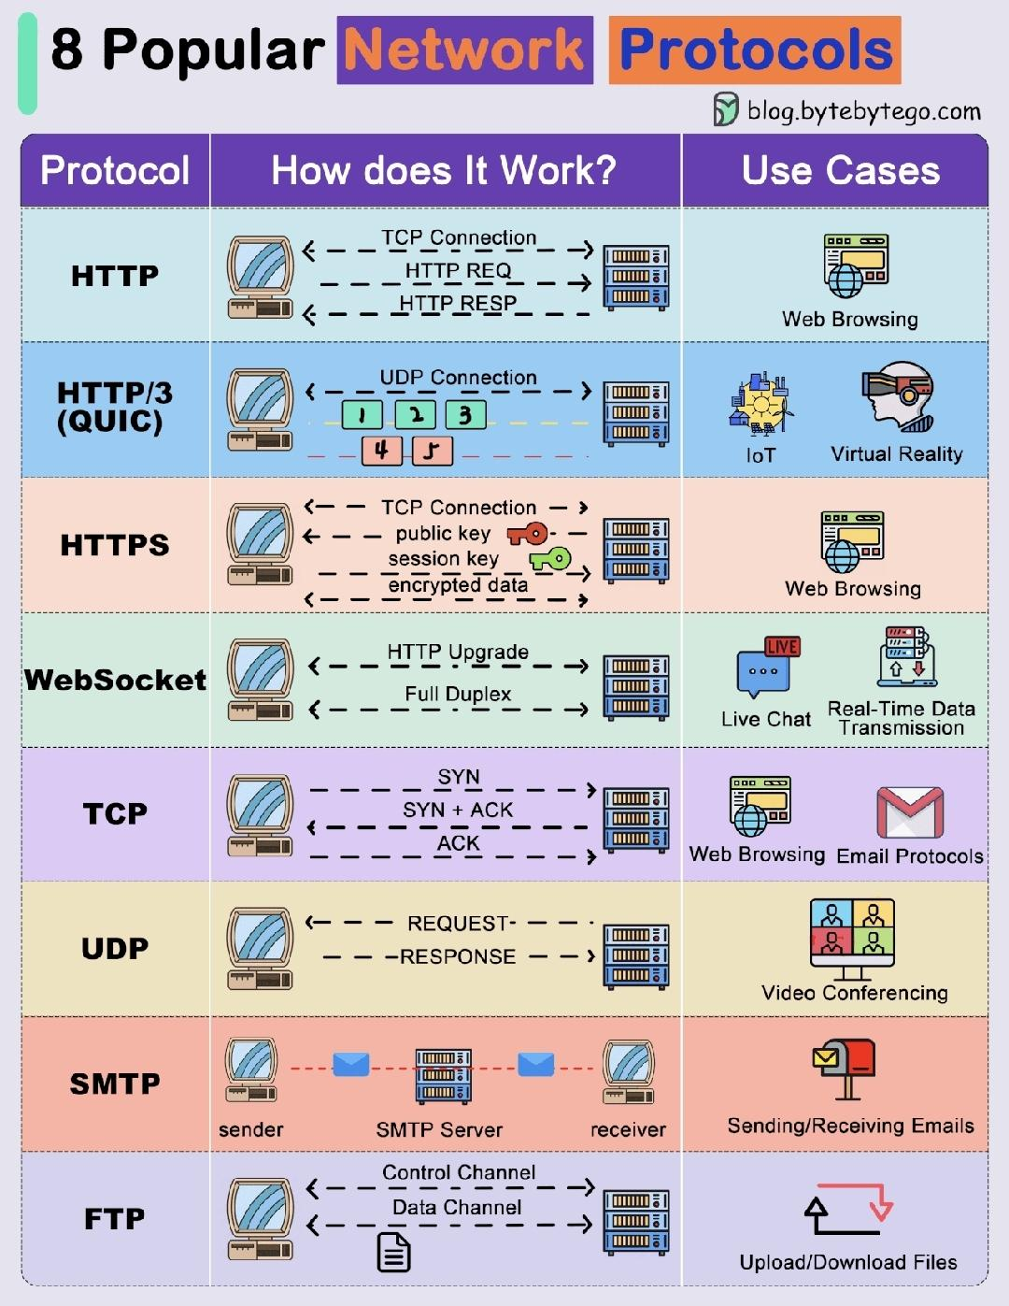
What are the alternative protocols?

Slide 12
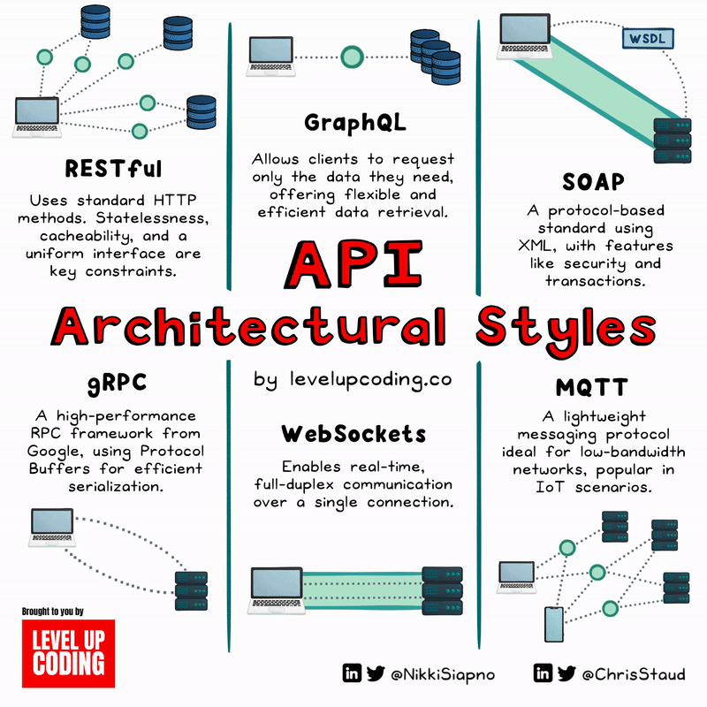
API Architectural Styles

Slide 13
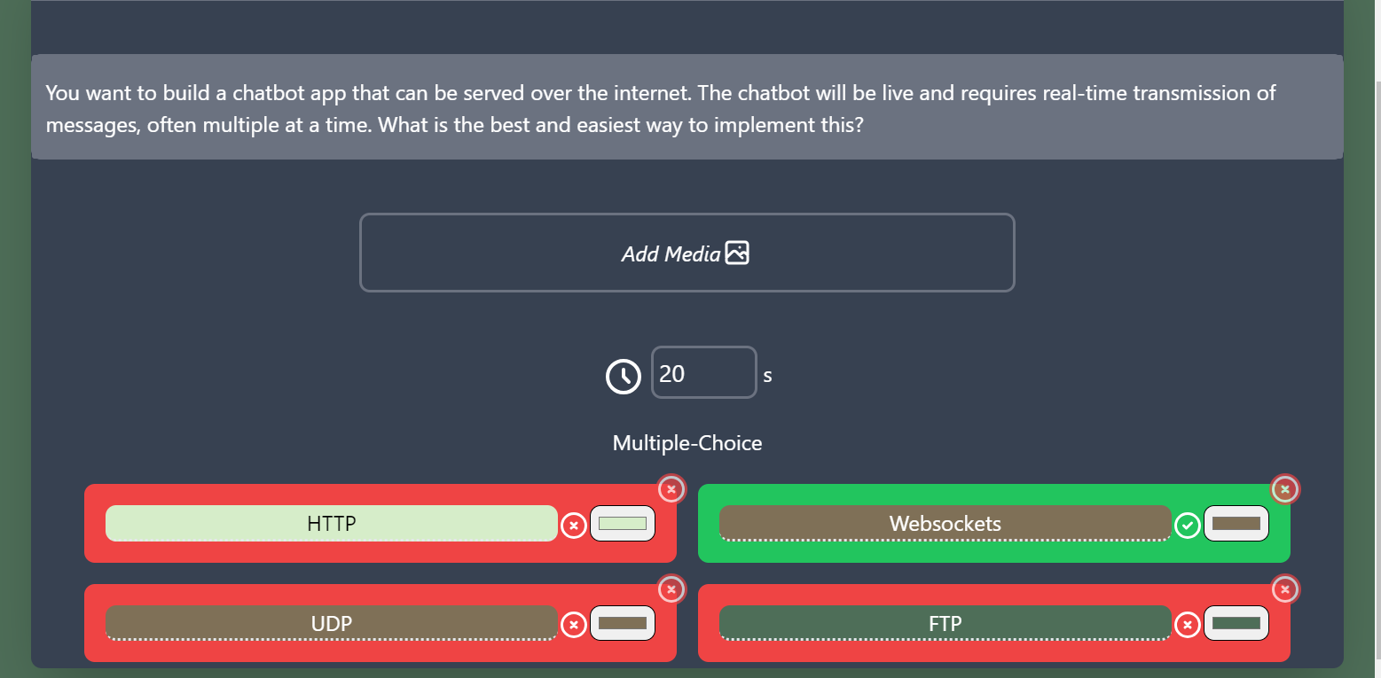

Slide 14
2.
Our overall model

Slide 15
Our overall model
Laptop request server for handshake
Server respond with handshake confirmation
Server push data to client when:
New player enters
Button is clicked
A player left
Laptop process data from server

Slide 16


Initial connection
“player_connected”
Handshake?
Connection
OK

Slide 17
New player connected
“player_connected”
Connection
Handshake?
Connection
OK

Slide 18
The button was pressed
“button_pressed”
“new_button_location”
Connection
Connection
“button_pressed”

Slide 19
A player disconnects
“player_disconnected”
Connection
Connection
Notes:
Player disconnects

Slide 20
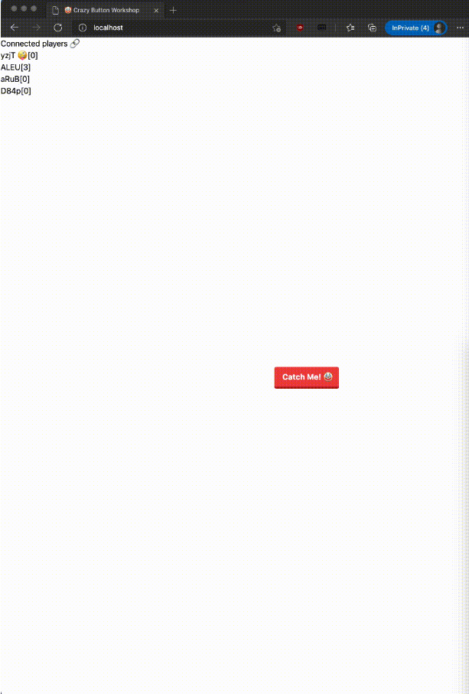
Frontend
Backend
Notes:
Frontend is what the user interact with
Backend is a server to does processing work

Slide 21
3.
Frontend Overview
Notes:
We will discuss core concepts but not the syntax of the codes

Slide 22
HTML tags
<html>...</html>
Put everything inside except <!DOCTYPE html>
<head>...</head>
Title
<body>...</body>
Main content
<script>...</script>
Javascript functions
Notes:
<html> tag is a standard convention
<!DOCTYPE html> is not a html tag. It tells the browser what document type to expect. For this case, its html

Slide 23
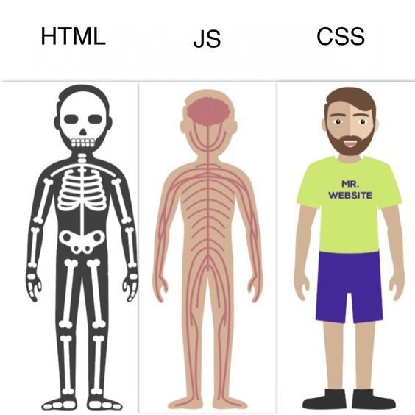
HTML, JS and CSS

Slide 24
4.
Backend Overview
Notes:
We will discuss core concepts but not the syntax of the codes

Slide 25
What we want on Backend
Logic for game
Generate and send a new button location when button is pressed
Ensure that all players are synced
Storage of stats
Store list of players and scores
Notes:
What we want to create in frontend

Slide 26
5.
Start Coding!
Notes:
We will discuss core concepts but not the syntax of the codes

Slide 27
5 Stages
Stage 1
Stage 2
Stage 3
Creating a minimal working skeleton
Polish and finish adding basic functions
Setup a basic server to serve skeleton
Stage 4
Stage 5
Bonus Stage
Integrate backend with frontend
Polish and debug
Creative time
https://bit.ly/SCSECrazyButton

Slide 28
Stage 1:
Frontend Crazy Button Skeleton

Slide 29
Stage 1 Demo

Slide 30
Stage 1 Overview
Purpose:
To create a skeletal html page with minimal crazy button logic
Key points:
How to set the webpage title
Simple HTML elements
Button
List
Manipulating DOM using JS
How to change the position of button
Inline CSS
position:absolute and what it means
Notes:
Explain what is DOM

Slide 31
Stage 1 Steps
HTML Setup
Set up a basic html page with your own page title
Add an unordered list of names and scores
Add a button
Add JS functions
moveButtonToLocation(randomTop, randomLeft)
window.innerHeight, window.innerWidth
document.getElementById()
button.style.top, button.style.left
handleButtonClick()
Math.random()
Link to button
Absolute position, onclick
Notes:
Facilitator to run through code first, then leave this screen for students to try. Students should not blindly copy paste

Slide 32
Stage 2:
Frontend Crazy Button with Score

Slide 33
Stage 2 Demo

Slide 34
Stage 2 Overview
Purpose:
Add score counting and fix some leftover issues
Key points:
JS
Global variable for playerListData
Data structures e.g. list, set, hashmap
How to load data from variables into DOM
Template literals
Conditional (ternary) operator
Manipulating DOM using JS
How to change element values (score)
Details and bug fixing

Slide 35
Stage 2 Steps
Create dynamic player list
Global variable to store player list
Functions to clear, draw player list
clearPlayerList()
drawPlayerList()
Template literals
text = `string content ${variable}`
Creating new HTML list item
document.createElement(“li”)
ListItem.appendChild(document.createTextNode(String))
UnorderedList.prepend(listElement)
Increase score every button click
Fix button out of screen bug
Notes:
Facilitator to run through code first, then leave this screen for students to try. Students should not blindly copy paste

Slide 36
Stage 3:
Basic Backend Server

Slide 37
Stage 3 Demo

Slide 38
Stage 3 Overview
Purpose:
Set up the basic operations on the backend
Key points:
Initialise server basics
How to serve the html we created in stage 2
Routing

Slide 39
Stage 3 Steps
Import necessary libraries
os
aiohttp.web
Initialise web application
web.Application()
Function to return index HTML page
Read HTML file
web.Response(text=f.read(), content_type='text/html')
Add routing
app.router.add_get(“route”, function)
Start server
web.run_app(app)
Notes:
Facilitator to run through code first, then leave this screen for students to try. Students should not blindly copy paste

Slide 40
Stage 4:
Integration Time

Slide 41
Stage 4 Demo

Slide 42
Stage 4 Overview - Server
Purpose:
Set up sockets, socket logic, and logging
Key points:
Websockets
Listen to and emit signals using sio library
Logic
Logging
Type alias/hinting

Slide 43
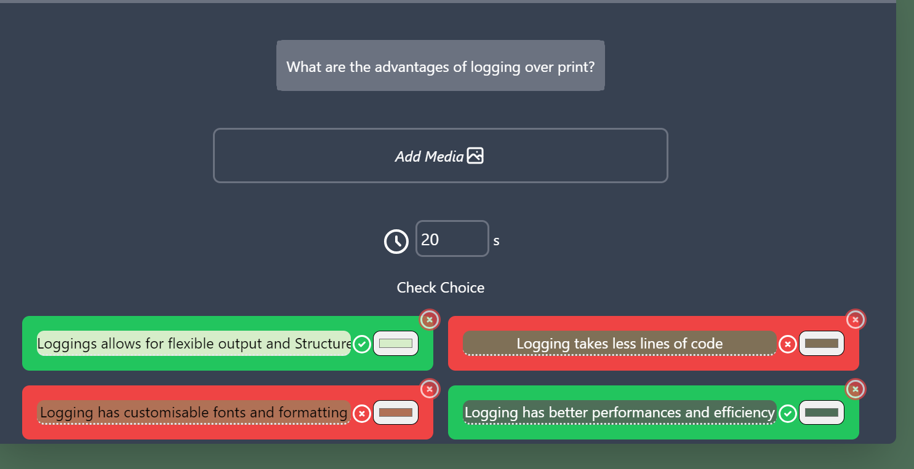

Slide 44
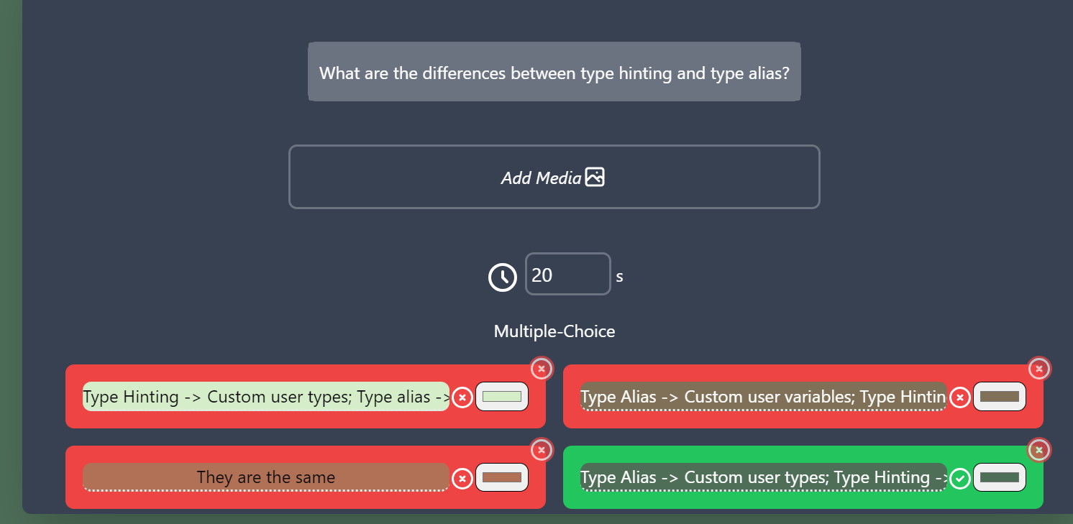

Slide 45
Stage 4 Steps - Server 1
Import necessary libraries
logging, random.uniform, typing_extensions.TypeAlias, typing_extensions.Dict, socketio
Set up logging
getLogger(), Formatter(), FileHandler(), StreamHandler(), Handler.setFormatter()
Set up socket
socketio.AsyncServer(logging= logger)
AsyncServer.attach(web.Application)
AsyncServer.logger.setLevel(logging.DEBUG)
AsyncServer.logger.addHandler()
Notes:
Facilitator to run through code first, then leave this screen for students to try. Students should not blindly copy paste

Slide 46
Stage 4 Steps - Server 2
Logic functions and variables
PlayerList
connect(sid, _)
disconnect(sid)
button_pressed(sid)
Handling signals
AsyncServer.emit(“event”)
@AsyncServer.on(“event”)
Function decorator
Async and await for coroutine functions
Notes:
Facilitator to run through code first, then leave this screen for students to try. Students should not blindly copy paste

Slide 47
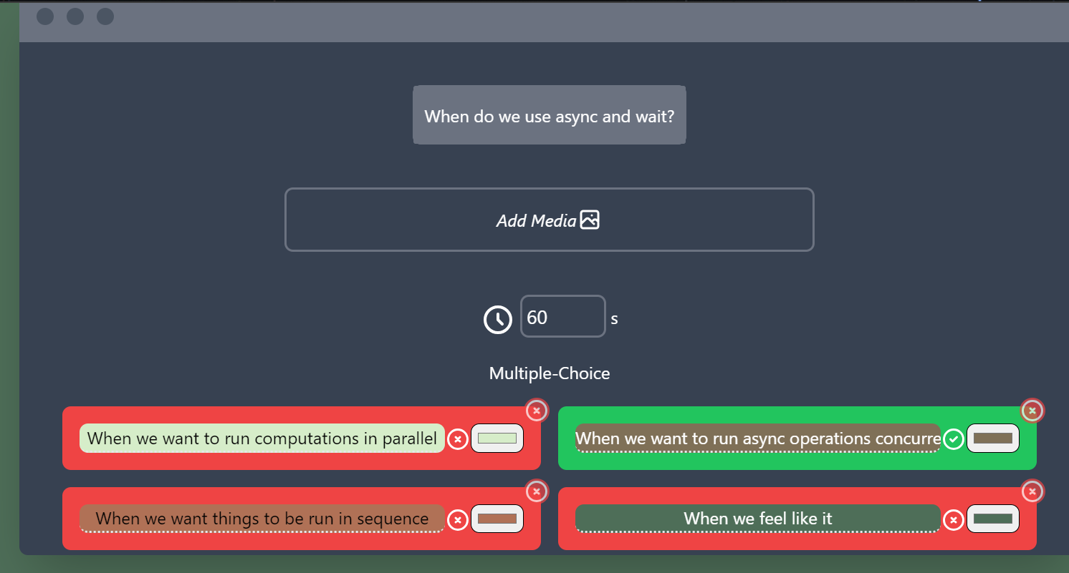

Slide 48
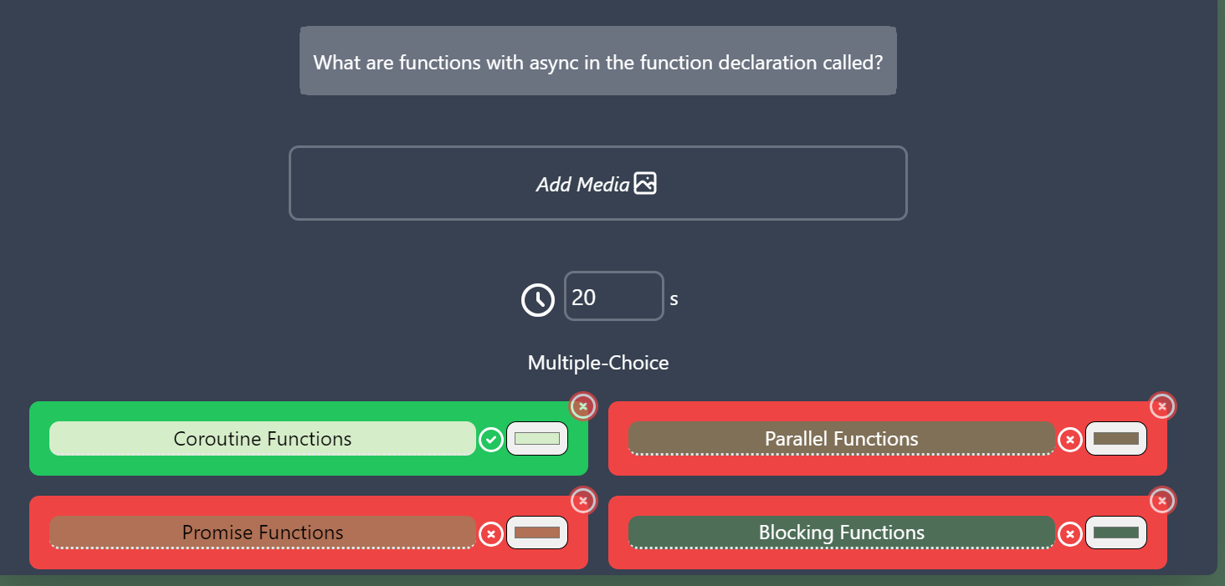

Slide 49
Stage 4 Steps - Server 3
TypeAlias and type hinting
Type Hint
var : Type
TypeAlias
NewType : Type[Type]
var : NewType
Notes:
Facilitator to run through code first, then leave this screen for students to try. Students should not blindly copy paste

Slide 50
Stage 4 Overview - Client
Purpose:
Linking client to server with socket
Key points:
How to import libraries
How to listen to and emit socket signals
Transferring logic from client to server
String slicing

Slide 51
Stage 4 Steps - Client
Import necessary libraries
<script src="https://cdnjs.cloudflare.com/ajax/libs/socket.io/4.0.1/socket.io.js" crossorigin="anonymous"></script>
Handover logic to server
handleButtonClick()
socket = io.connect()
socket.on(“event”, (data) => { function(data.attribute); });
Polish
reDrawPlayerList() → Convenience function
drawPlayerList()
String.slice(start, end);
Notes:
Facilitator to run through code first, then leave this screen for students to try. Students should not blindly copy paste

Slide 52
Stage 5:
Debug and Polish

Slide 53
Stage 5 Demo

Slide 54
Stage 5 Overview - Server
Purpose:
Clean up and fix button initial location bug
Key points:
Sending signals to specific users

Slide 55
Stage 5 Steps - Server
Update the button location upon connection as well, instead of only after click
Only send it to the connected user
Notes:
Facilitator to run through code first, then leave this screen for students to try. Students should not blindly copy paste

Slide 56
Stage 5 Overview - Client
Purpose:
CSS and polish
Key points:
How to use css
Mark player on playerList

Slide 57
Stage 5 Steps - Client 1
Mark the player on the player list
socket.id → Player/User’s sid
Link tailwind styling library
<link href="https://unpkg.com/tailwindcss@^2/dist/tailwind.min.css" rel="stylesheet" type="text/css"/>
Notes:
Facilitator to run through code first, then leave this screen for students to try. Students should not blindly copy paste

Slide 58
Stage 5 Steps - Client 2
Style the button with tailwind predefined classes
absolute
flex-auto
bg-red-500
hover:bg-red-400
text-white
font-bold
py-2
px-4
border-b-4 border-red-700
hover:border-red-500
rounded
Notes:
Facilitator to run through code first, then leave this screen for students to try. Students should not blindly copy paste

Slide 59
Bonus Stage:
Creative Time

Slide 60
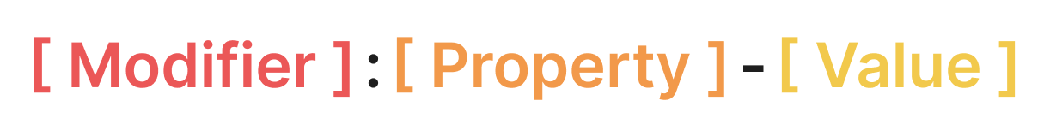
Bonus Stage - TailwindCSS
Event States
Abbreviated CSS Properties
Applicable Values
Width | w
Height | h
Padding | p
Margin | m
Background Color | bg
Left | l
Right | r
Top | t
Bottom | b
Color-Shade | cyan-500
Numerical | 1, 2, ..
Size | xs, sm, md, lg
Custom | [200px]
Bottom | b
Notes:
Facilitator to run through code first, then leave this screen for students to try. Students should not blindly copy paste

Slide 61
Bonus Stage - TailwindCSS
Applicable Values
Event States
Abbreviated CSS Properties
Notes:
Facilitator to run through code first, then leave this screen for students to try. Students should not blindly copy paste

Slide 62
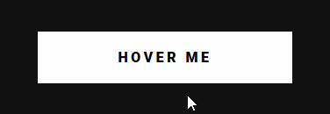
Bonus Stage - TailwindCSS
Applicable Values
Event States
Abbreviated CSS Properties
Modifiers are special state of the selected element
The utility class (eg. color-blue-500) is applied when the state condition is satisfied
Hover: Triggers when element is being hovered by mouse
Focus: Triggers when element is focused (ie. Focused after being clicked)
Active: Triggers as element is being clicked
Notes:
Facilitator to run through code first, then leave this screen for students to try. Students should not blindly copy paste

Slide 63
Bonus Stage - TailwindCSS
Applicable Values
Event States
Abbreviated CSS Properties
Properties are abbreviations of CSS Properties
Check out Tailwind Documentation for all supported CSS Properties
Position: Fixed (fixed), Relative (relative), Flex (flex)
Size: Width (w-), Height (h-), Padding (p[position]-), Margin (m[position]-)
Colour: Background Colour (bg-)
Text: Includes text sizing, spacing, colours and etc. (text-)
Notes:
Facilitator to run through code first, then leave this screen for students to try. Students should not blindly copy paste

Slide 64
Bonus Stage - TailwindCSS
Applicable Values
Event States
Abbreviated CSS Properties
Values are appropriate values that can be set for relevant of properties
Size: Numerical (-1, -2, …) or Text (-sm, -md, -lg, -auto)
Colour: (-red-[shade], -orange-[shade], -yellow-[shade])
Specific: Values specific to certain elements (-center)
Custom: Some values can be custom too! (-[200px])
Notes:
Facilitator to run through code first, then leave this screen for students to try. Students should not blindly copy paste

Slide 65
CSS Demo

Slide 66
Additional Tasks

Slide 67
Extra tasks
Having everything in one file is messy, how to move the JS out of the HTML?
How to sort player list according to score?
The button will obscure the playerlist sometimes, find a way to prevent that.
How to bold and make your name shine on the leaderboard?
Make your name special using css
Polish up the looks, css make the page just as clothes make the man.
What’s the point of a server if you can’t play it with friends, right? Find a way to play the same game instance with the friend beside you.

Slide 68
Addendum: Deploying your Code

Slide 69




Questions
Congrats on completing your code!
If this was a personal project, you might want to deploy your code.
There are many web hosting service companies available, e.g.

Slide 70
Questions
But note that not all service providers might support your tech stack / framework / architecture.
For example, Vercel uses serverless functions and cannot support websockets out-of-the-box:
https://vercel.com/guides/do-vercel-serverless-functions-support-websocket-connections

Slide 71
Quiz Time

Slide 72
Questions
When to use async and await?
What are functions with async in function declaration called?
What are the cases where index() needs to be a coroutine function?
What are the advantages of logging over using print?
How are type aliases different from type hinting?
Why do we want to send signals to specific individuals instead of broadcasting all the time?
How do we include style sheets and libraries in JS?
Name one way to get a specific HTML element and modify it.
What are template literals and how are they used?
What is absolute positioning, and what would happen to the application without it?

Slide 73
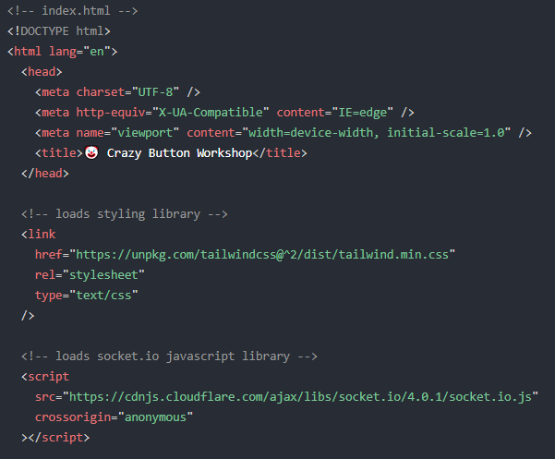
index.html
Notes:
Moving on the the code itself, the file should be named index.html
It should contain
Header tag
Boilerplate code with title of the webpage
written text that can be reused in new contexts or applications without significant changes to the original.
We will be importing
Tailwind CSS
Styling library. Will be used for the button
Socket.IO
socket script that we will be using
Now lets move on to the helper functions

Slide 74
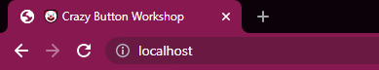
index.html

Slide 75
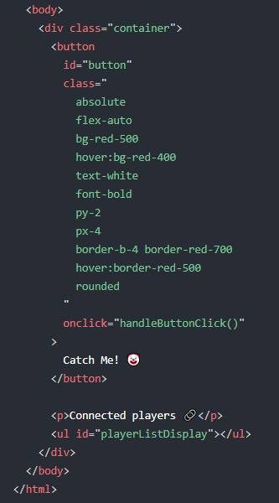
Body of index.html
Notes:
The body only contains a button and the leaderboard list

Slide 76
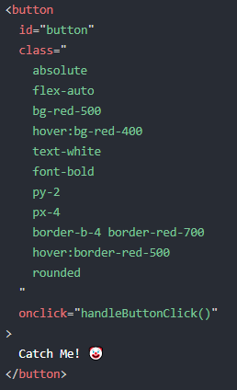
Button
Notes:
We will start with the button
We give it an id=”button” to identify it, we will be referencing this button in other parts of the code.
That’s why we need to give it an identification
We style of the button
color , size, etc using tailwind CSS
Here we specify that when the button is clicked, we activate handleButtonClick() helper function
Lastly this is what to be displayed in the button

Slide 77
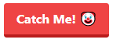
Button
Notes:
Here is what the button looks like with the text and styling

Slide 78
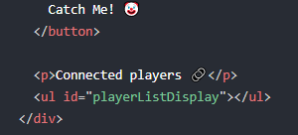
Leaderboard
Notes:
Next part of the body is the leaderboard
First we create a label “Connected players”
Then we create an unordered list with id=”playerListDisplay

Slide 79
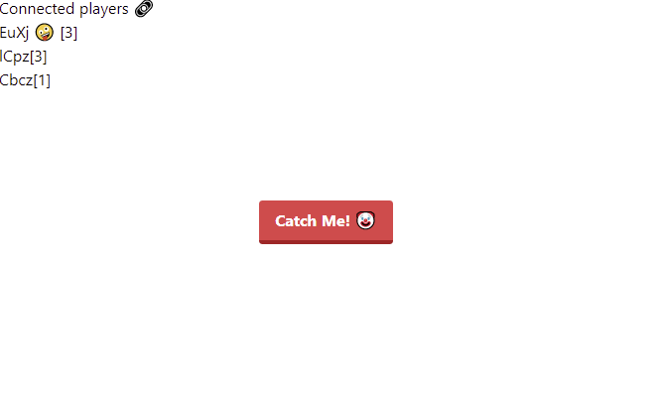
Frontend

Slide 80
index.html
Notes:
We will be importing
Tailwind CSS
Styling library. Will be used for the button
Socket.IO
socket script that we will be using
Now lets move on to the helper functions

Slide 81
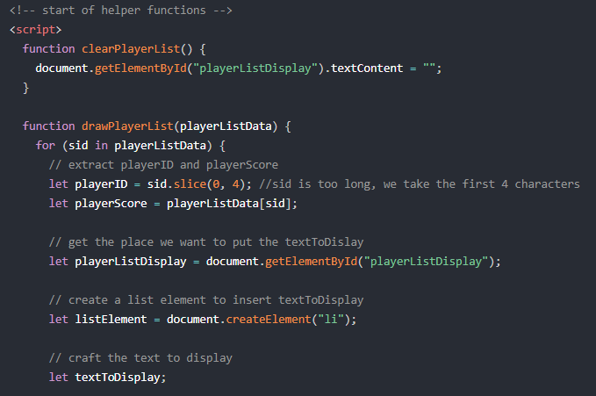
Helper functions
Notes:
The helper functions which are the logic that of the webpage. Written in js
Meaning, it contains instructions of what to do when certain actions occur
Let’s look through them one by one

Slide 82
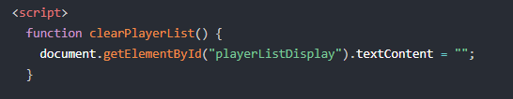
Function clearPlayerList
Notes:
clearPlayerList function
Deletes the leaderboard list

Slide 83
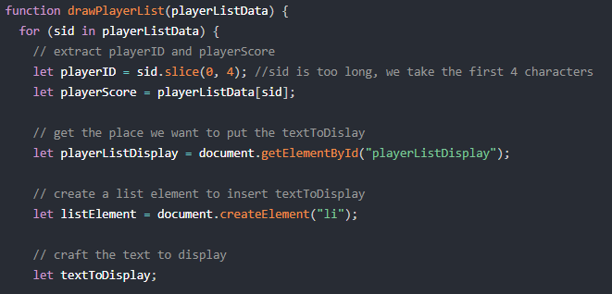
Function drawPlayerList
Notes:
drawPlayerList function
This function takes in playerListData
It will go through all the players in the list one by one
And for each player, We want to do execute these codes=>
Now lets look at what is playerListData and sid

Slide 84
playerListData
sid
score
{
“SdxtrkjLGVUlkjhnuiYTFTR”: 0
“6ppaCTQL4rjH1r7jAAAD0”: 1
“1iiPOUOJQKVh6ol9AAABs”: 2
}
Notes:
This is what playerListData looks like
Its a list that contains
A list of sid(player) along with their respective score
What this code means is
We are going through the list one by one

Slide 85
Function drawPlayerList
Notes:
We set playerID as the first 4 characters on sid
Since sid is too long

Slide 86
Function drawPlayerList
Eg. sid = “SdxtrkjLGVUlkjhnuiYTFTR”
playerID = “Sdxt”
Notes:
Here is an eg of sid
We take the first 4 characters and playerID

Slide 87
Function drawPlayerList
Notes:
Moving on, we
Get player score from the list using the id
Get the location on the webpage where we want to display the Leaderboard
Create a list element to put some text
Create the variable textToDisplay

Slide 88
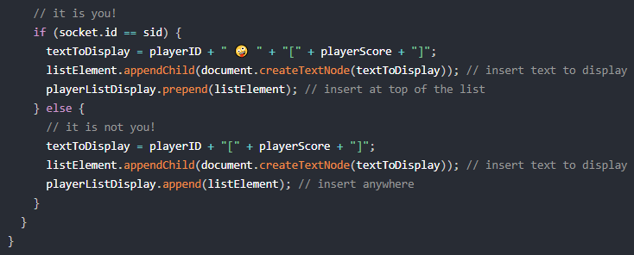
Function drawPlayerList
Notes:
Next, the function will check if the player in the list is you or not
First we look at when the player is you

Slide 89
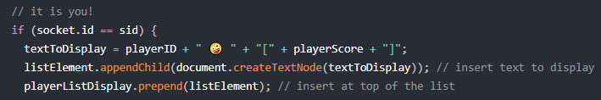
Function drawPlayerList
Notes:
If it is you
We want textToDisplay to contain a text string with your id, an emoji and your score

Slide 90
Function drawPlayerList
Notes:
Create a list element using the text
Put to the TOP of the list

Slide 91
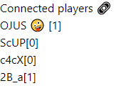
Function drawPlayerList
Notes:
Create a list element using the text
Put to the element to the bottom of the list
With this, we completed this function

Slide 92
Function drawPlayerList
Notes:
Now we look at what if the player is not you

Slide 93
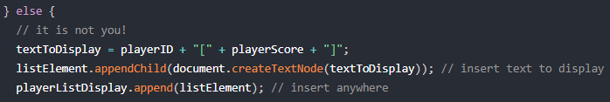
Function drawPlayerList
Notes:
We want to create a text string with the player’s id and the player’s score

Slide 94
Function drawPlayerList
Notes:
Create a list element using the text
Put to the element to the bottom of the list
With this, we completed this function

Slide 95
Function drawPlayerList
Notes:
Create a list element using the text
Put to the element to the bottom of the list
With this, we completed this function

Slide 96
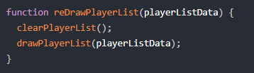
Function reDrawPlayerList
Notes:
Moving onto reDrawPlayerList function
It calls 2 helper functions we mentioned before
Clear the list
Draw the list

Slide 97
Function drawPlayerList
Notes:
Create a list element using the text
Put to the element to the bottom of the list
With this, we completed this function

Slide 98
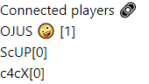
Function drawPlayerList
Notes:
Create a list element using the text
Put to the element to the bottom of the list
With this, we completed this function

Slide 99
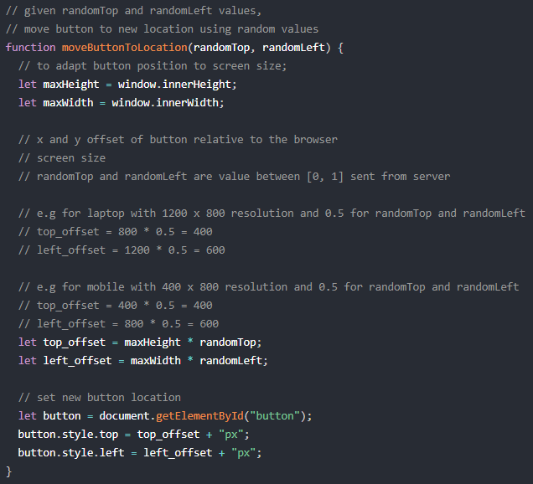
Function moveButtonToLocation
Notes:
Next up is the moveButtonToLocation function

Slide 100
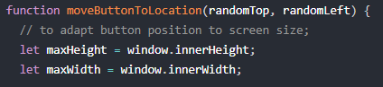
Function moveButtonToLocation
Notes:
This function take in 2 variable which we will be using later.
First, we get the height and width of the player’s screen
Different players have different screen size
We need to adapt our button position base on their screen sizes
So the button we appear in the same position on all the screens

Slide 101
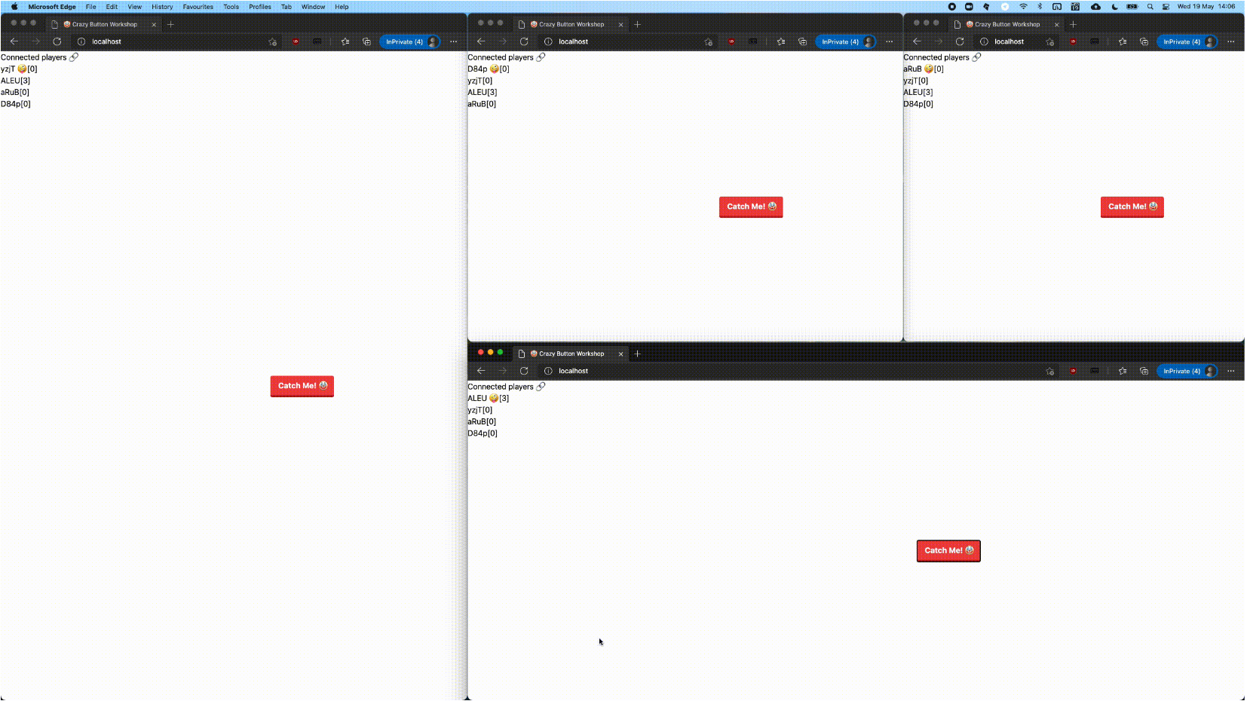
Notes:
Here’s a picture to help you better visualise what we are doing.
We can see there are different screen sizes

Slide 102
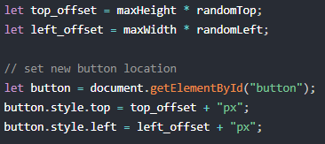
Function moveButtonToLocation
Notes:
Now we calculate the offset of the button from the top and left hand side of the screen
Done by multiplying the height and and width of the screen with the random variables that was passed into the function
Why?
Can anyone guess
randomTop and left is a value between 0 and 1
So its a decimal value and is like a percentage
Eg. 0.2 = 20%
0.1453 = 14.53%
0.0001 = 0.01%
Using percentage, we can get the relative position of the button across all screen sizes
Then we set the new position of the button based on the calculated offsets

Slide 103
top_offset
left_offset
Notes:
Here’s a picture to help you better visualise what we are doing.
And the position of the button is based on the top and left offset of the respective screens

Slide 104
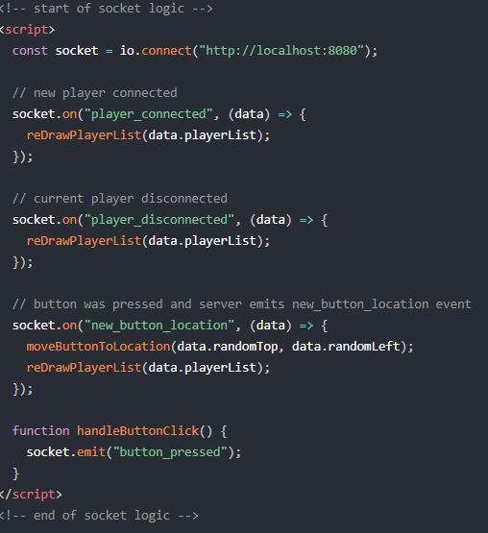
Socket logic
Notes:
Now we move on the socket logic
These codes contain logic of the socket
Meaning, what to do when the client receive or send out data
The socket will call respective helper functions when it detects certain actions
We will examine the codes part by part

Slide 105
Socket logic
socket.on(...)
receiving
socket.emit(...)
sending
Notes:
2 types on socket
On and emit
On = receiving
Emit = sending

Slide 106
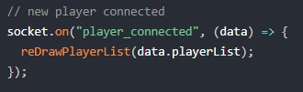
New player
Notes:
When client side socket receives that a new player have joined the game, along with the new data,
It will redraw the leaderboard to include the new player by calling the reDrawPlayerList() helper function and passing the playerlist data into the function

Slide 107
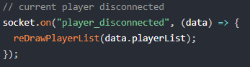
Player disconnects
Notes:
When client side socket receives that a player disconnects
It will redraw the leaderboard also

Slide 108
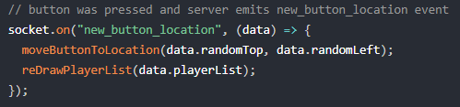
New button location
Notes:
When client side socket receives that the button have been pressed
It will move button to new location and redraw the leaderboard

Slide 109
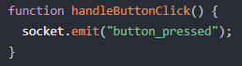
Button pressed
Notes:
When button has been pressed
Client will send out “button_pressed” through the socket
This is the end of socket logic, we can move one to the body of the html file

Slide 110
Frontend

Slide 111
3.2
Backend codes
Notes:
Now let move on the to backend codes

Slide 112
What we want on Backend
Server to emit player_connected event when new player joins in
Sends a list of connected players
Server to emit player_disconnected event when player disconnects
Sends a list of connected players

Slide 113
What we want on Backend
Server to emit new_button_location event when a player clicks the button
Take note who clicked it and update the score
Calculate random values for button to move
Send the random values and list of connected players

Slide 114
What we want on Backend
Current connected playerList should have
playerID
playerScore

Slide 115
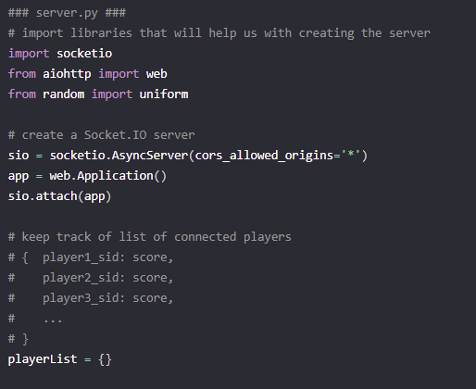
server.py
Notes:
Importing libraries that we need
Creating the socket
Creating a list that will be use to store playerID and their score
//change player_id to player_sid

Slide 116
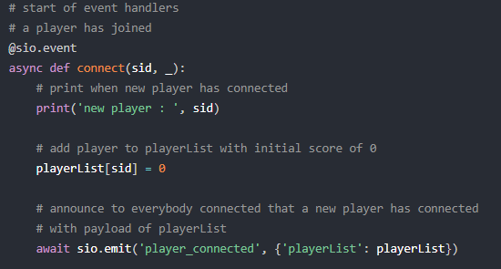
New player joined event
Notes:
Specify that the function we are going to write below is a socket event

Slide 117
New player joined event
Notes:
This function takes in sid of the new player
Sid is a unique string of characters to represents a player
Print out sid of new player in the server
Add the player to the list with score of 0
Server send out “player_connected” and the playerList data

Slide 118
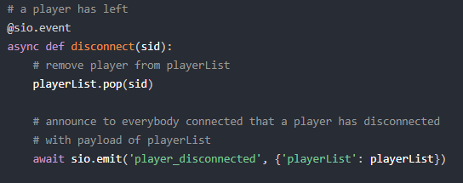
Player disconnected event
Notes:
Specify that what we are going to write below is a socket event
Takes in sid of the disconnected player
Remove the player from the playerList
Server sends out “player_disconnected” along with the updated playerList

Slide 119
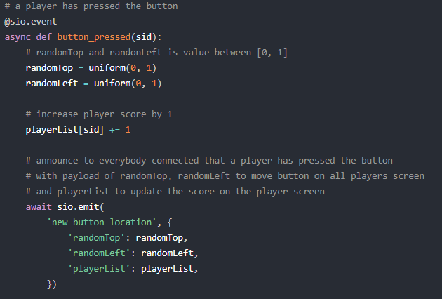
Button pressed event
Notes:
Specify below function is an event
Take in sid of player who clicked the button
Create random values to move the button
Increment the score of the player who clicked the button
Server send out “new_button_location” and the 2 random values along with the updated playerList
End of last event

Slide 120
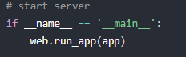
Start server
Notes:
This code just starts the server

